Slide 1

Factory Method DESIGN (ANTY-)PATTERNS Coffee Break

Slide 2
Factory Method - Intent
GoF: this pattern “defines an interface for creating an object, but let subclasses decide which class to instantiate. The Factory method lets a class defer instantiation to subclasses”.

Slide 3
Factory Method - Intent
GoF: this pattern “defines an interface for creating an object, but let subclasses decide which class to instantiate. The Factory method lets a class defer instantiation to subclasses”.
Creational Design Patterns: Factory Method, Abstract Factory, Builder, Singleton, Object Pool, Prototype

Slide 4
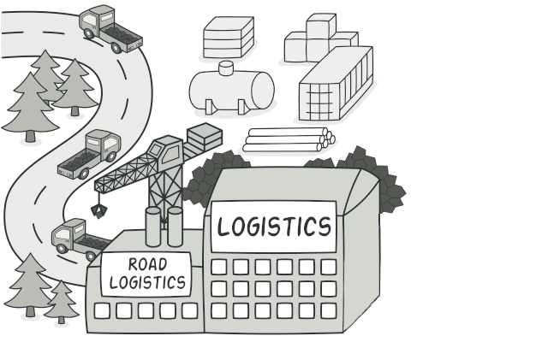
Factory Method – Real World Example
Imagine that you’re creating a logistics management application. The first version of your app can only handle transportation by trucks, so the bulk of your code lives inside the Truck class.

Slide 5
Factory Method – Real World Example
After a while, your app becomes pretty popular. As you receive dozens of requests from sea transportation companies you decide to incorporate sea logistics into your scope.

Slide 6
Factory Method – Real World Example
Great news, right?

Slide 7
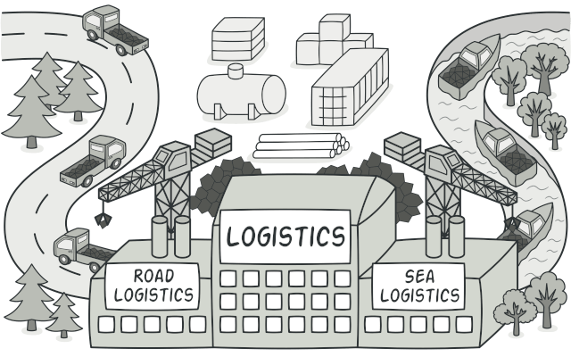
Factory Method – Real World Example
Great news, right?

Slide 8
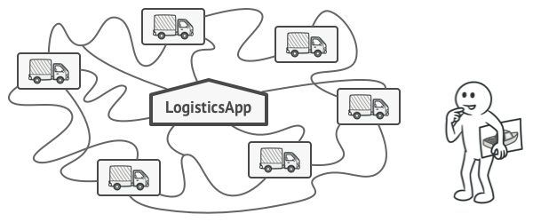
Factory Method – Real World Example
But how about the code? At present, most of your code is coupled to the Truck class. Adding Ships into the app would require making changes to the entire codebase. Moreover, if later you decide to add another type of transportation to the app, you will probably need to make all of these changes again.

Slide 9
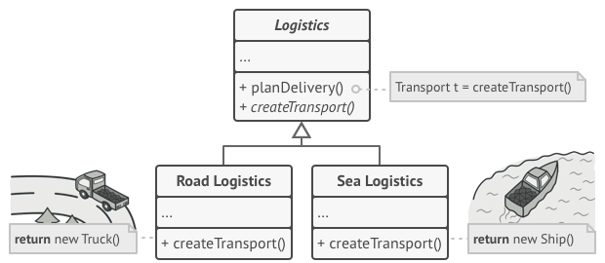
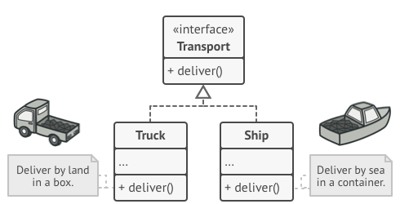
Factory Method – Real World Example
Solution: The Factory Method pattern suggests that you replace direct object construction calls (using the new operator) with calls to a special factory method. (At first glance, this change may look pointless. However, there is a big difference between requesting an object and creating one.)

Slide 10
Factory Method – Real World Example
Solution: Both Truck and Ship classes should implement the Transport interface, which declares a method called deliver. Each class implements this method differently: trucks deliver cargo by land, ships deliver cargo by sea. The factory method in the RoadLogistics class returns truck objects, whereas the factory method in the SeaLogistics class returns ships.

Slide 11
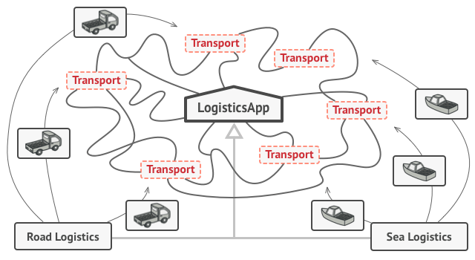
Factory Method – Real World Example
Solution: As long as all product classes implement a common interface, you can pass their objects to the client code without breaking it. The client treats all the products as abstract Transport. The client knows that all transport objects are supposed to have the deliver method, but exactly how it works isn’t important to the client.

Slide 12
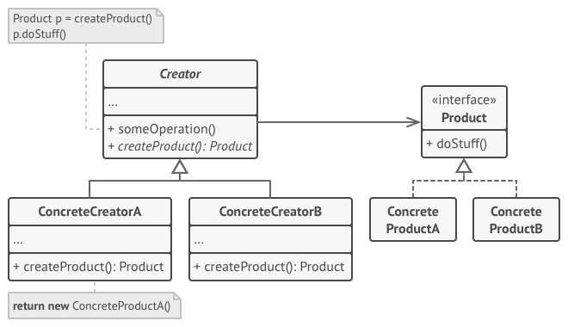
Factory Method – Real World Example
Solution: UML Class Diagram

Slide 13
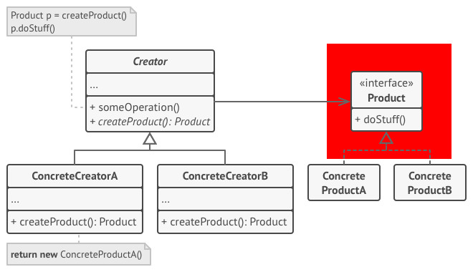
Factory Method – Real World Example
Solution: The Product declares the interface, which is common to all objects that can be produced by the creator and its subclasses.

Slide 14
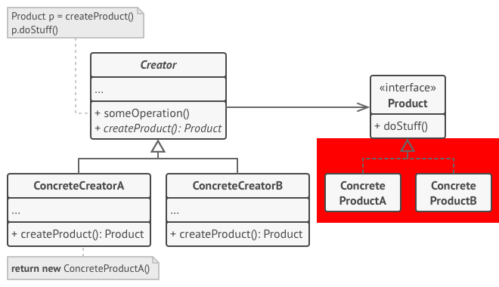
Factory Method – Real World Example
Solution: Concrete Products are different implementations of the product interface.

Slide 15
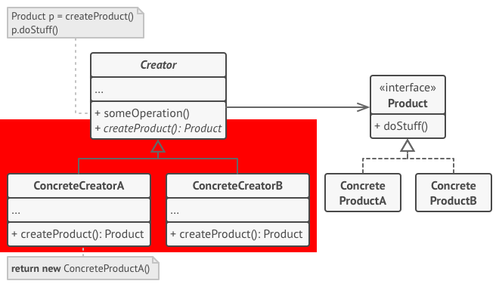
Factory Method – Real World Example
Solution: The Creator class declares the factory method that returns new product objects. It’s important that the return type of this method matches the product interface.

Slide 16
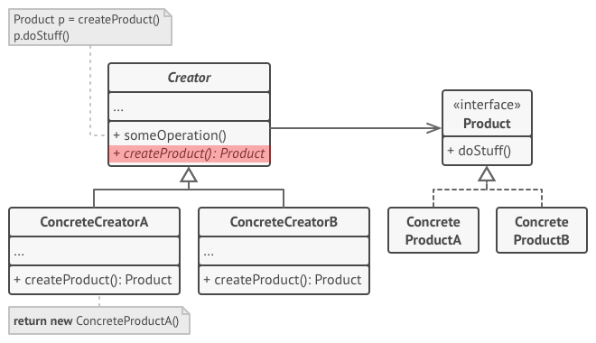
Factory Method – Real World Example
Solution: You can declare the factory method as abstract to force all subclasses to implement their own versions of the method. As an alternative, the base factory method can return some default product type.

Slide 17
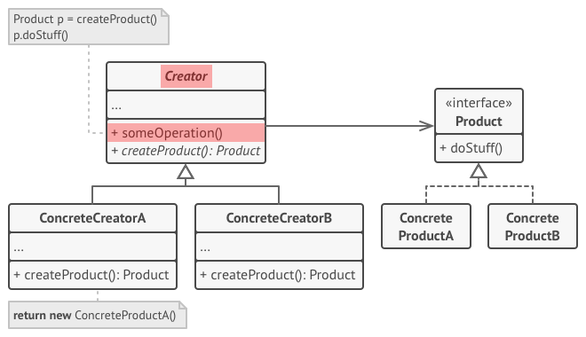
Factory Method – Real World Example
Solution: Note, despite its name, product creation is not the primary responsibility of the creator. Usually, the creator class already has some core business logic related to products. The factory method helps to decouple this logic from the concrete product classes.

Slide 18
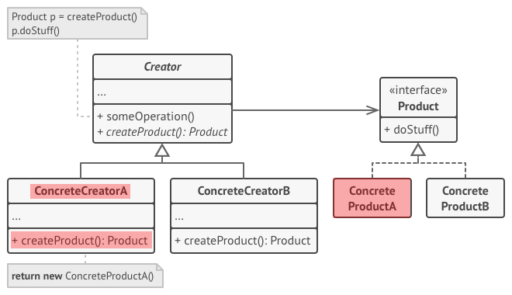
Factory Method – Real World Example
Solution: Concrete Creators override the base factory method so it returns a different type of product. Note that the factory method doesn’t have to create new instances all the time. It can also return existing objects from a cache, an object pool, or another source.

Slide 19
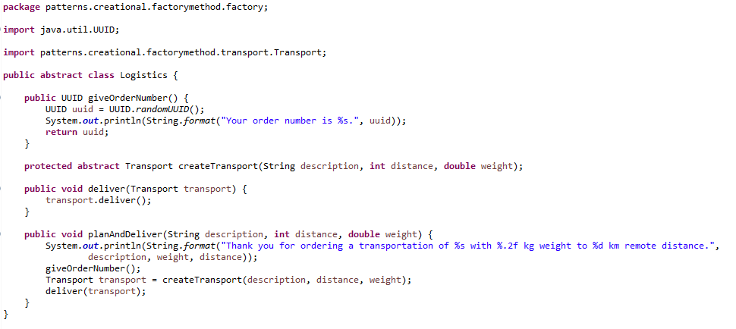
Factory Method – Real World Example
Notice: See the attached source code of the whole LogisticsApp

Slide 20
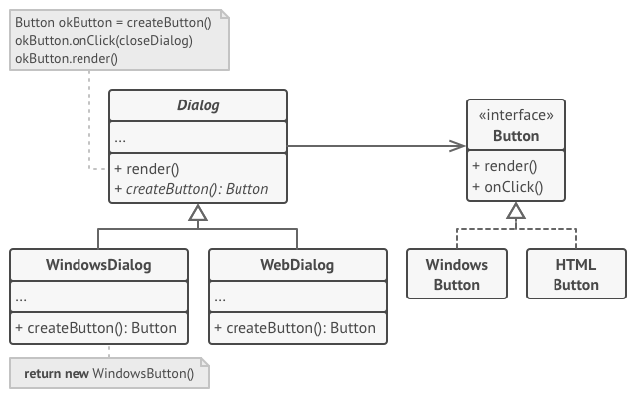
Factory Method – Real World Example II
Notice: The cross-platform dialog example. This example illustrates how the Factory Method can be used for creating cross-platform UI elements without coupling the client code to concrete UI classes.

Slide 21
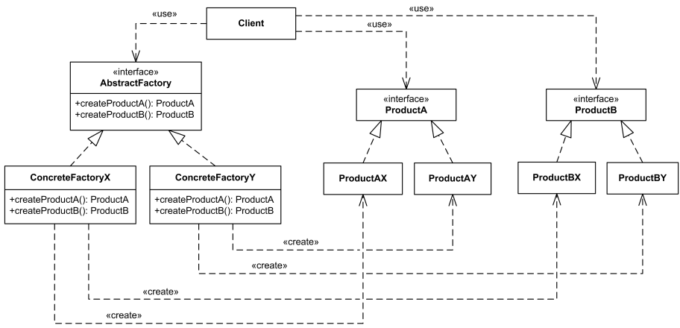
Factory Method – Real World Example II
Notice: Of course, you can apply this approach to other UI elements as well. However, with each new factory method you add to the dialog, you get closer to the Abstract Factory pattern.

Slide 22
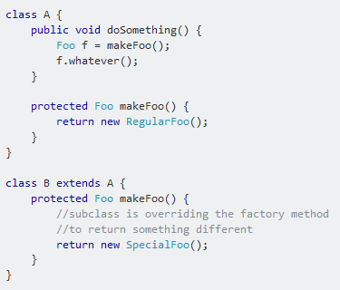
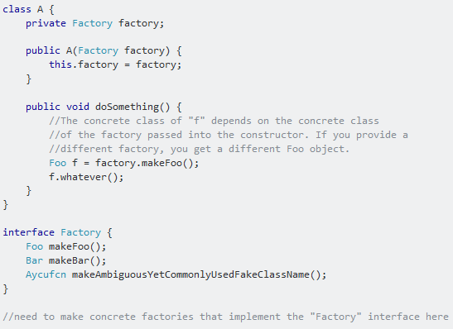
Factory Method vs. Abstract Factory

Slide 23
Factory Method – Applicability

Slide 24
Factory Method – Applicability
You don’t know beforehand the exact types and dependencies of the objects your code should work with.

Slide 25
Factory Method – Applicability
You don’t know beforehand the exact types and dependencies of the objects your code should work with.
You want to provide users of your library or framework with a way to extend its internal components

Slide 26
Factory Method – Applicability
You don’t know beforehand the exact types and dependencies of the objects your code should work with.
You want to provide users of your library or framework with a way to extend its internal components
You want to save system resources by reusing existing objects instead of rebuilding them each time

Slide 27
Factory Method – Pros and Cons
You avoid tight coupling between the creator and the concrete products.
Single Responsibility Principle. You can move the product creation code into one place in the program, making the code easier to support.
Open/Closed Principle. You can introduce new types of products into the program without breaking existing client code.
The code may become more complicated since you need to introduce a lot of new subclasses to implement the pattern.

Slide 28
Factory – An ambiguous term
Factory is an ambiguous term that stands for a function, method or class that supposed to be producing something.
a function or method that creates program’s GUI
a static method that calls a class constructor in a certain way
a class that creates users
one of the creational design patterns

Slide 29
Relations with Other Patterns
Factory Method is a specialization of Template Method. At the same time, a Factory Method may serve as a step in a large Template Method.
Many designs start by using Factory Method and evolve toward Abstract Factory, Prototype, or Builder
Abstract Factory classes are often implemented with Factory Methods, but they can be implemented using Prototype.
Factory Method: creation through inheritance. Prototype: creation through delegation. Prototype doesn't require subclassing, but it does require an Initialize operation. Factory Method requires subclassing, but doesn't require Initialize.
You can use Factory Method along with Iterator to let collection subclasses return different types of iterators that are compatible with the collections.

Slide 30

Factory Method - Discussion

Slide 31
Factory Method - References
Safari Books
Design Patterns and Best Practices in Java https://learning.oreilly.com/library/view/design-patterns-and/9781786463593/069027bf-63c7-4326-a9e6-ef8af2f6d79c.xhtml
Design Patterns in Java, Second Edition https://learning.oreilly.com/library/view/design-patterns-in/9780321630483/ch16.html
Online Sites
https://en.wikipedia.org/wiki/Software_design_pattern
http://www.blackwasp.co.uk/FactoryMethod.aspx
https://sourcemaking.com/design_patterns/factory_method
https://www.tutorialspoint.com/design_pattern/factory_pattern
https://refactoring.guru/design-patterns/factory-method

